Slide 1
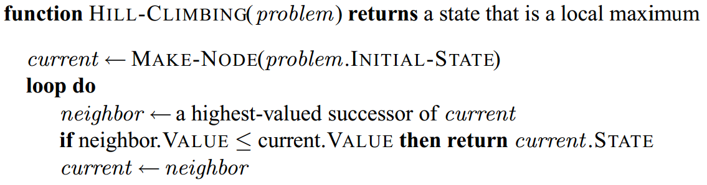
Russell & Norvig, Fig 4.2

Slide 2
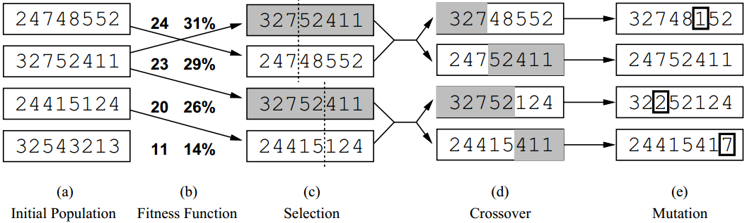
Russell & Norvig, Fig 4.6

Slide 3
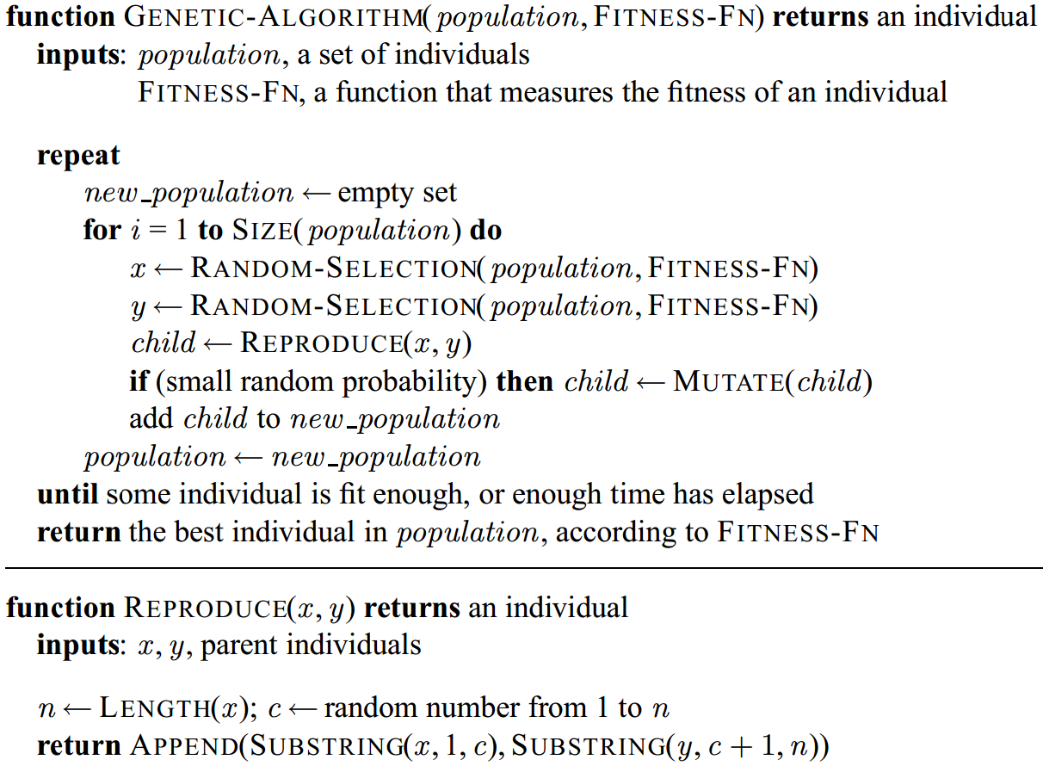
Russell & Norvig, Fig 4.8

Slide 4
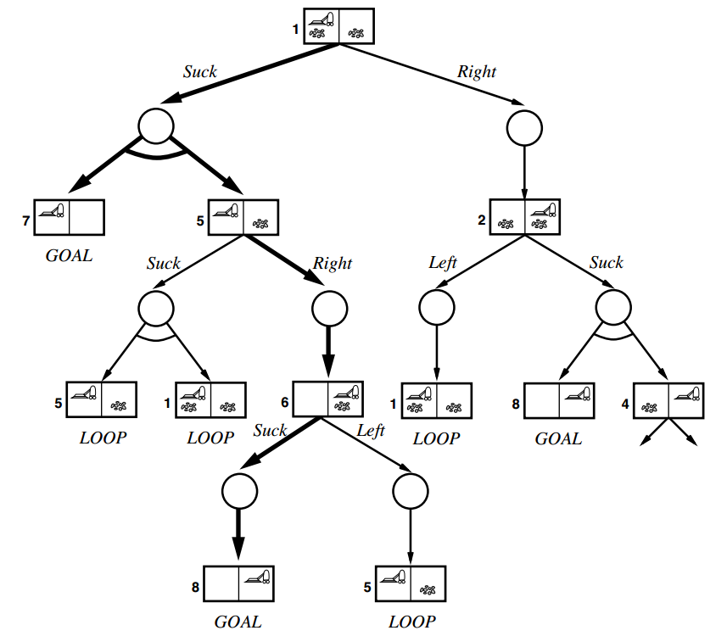
Erratic vacuum world
Russell & Norvig, Fig 4.10

Slide 5
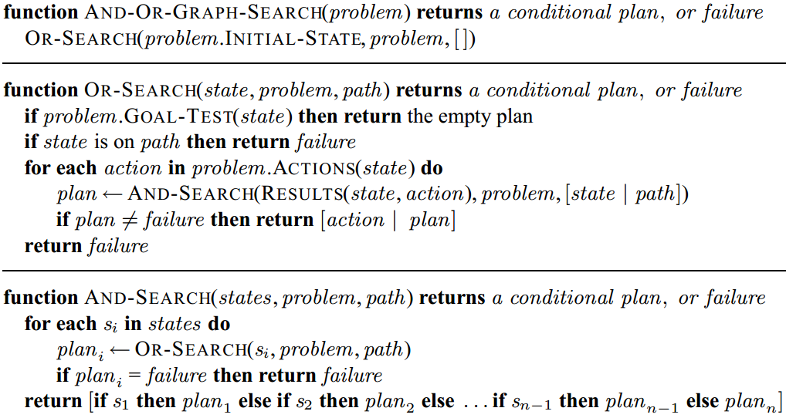
Russell & Norvig, Fig 4.11

Slide 6
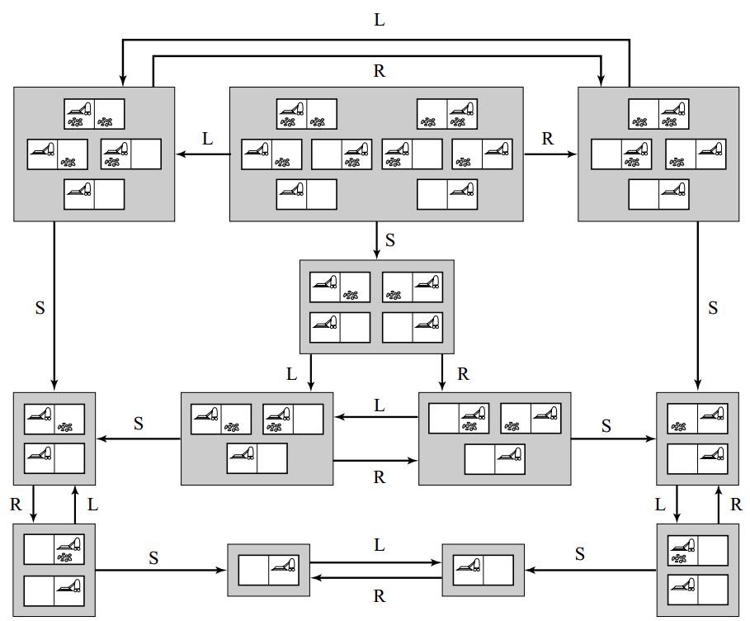
Belief state space for sensorless vacuum world
Russell & Norvig, Fig 4.14

